Slide 1
WAVENTURE
By
LEFEBVRE Romain
HIRTH Quentin
LEDRU Solal
CARRE Arthur

Slide 2
Summary
What is Waven
How the idea came to be
Presentation video
How it works
Our code

Slide 3
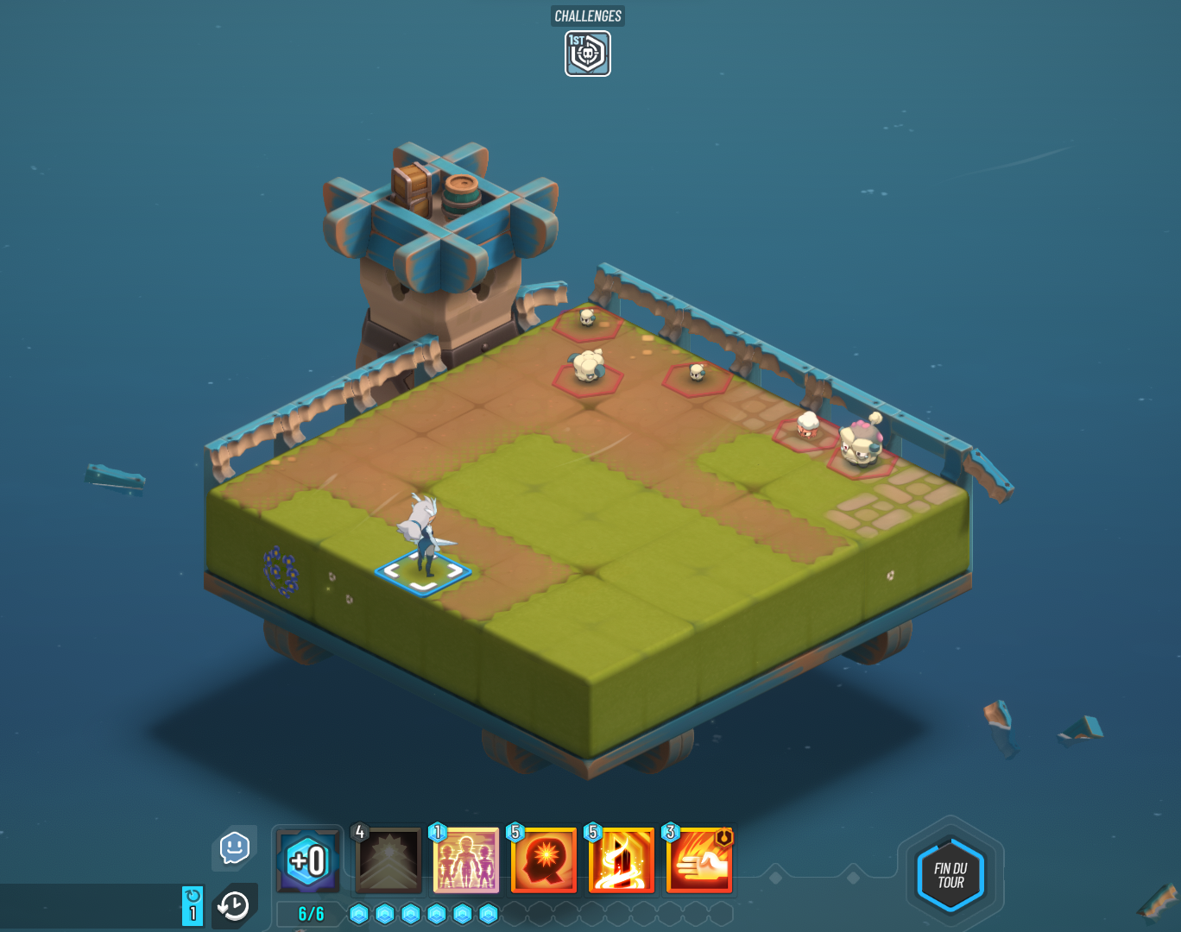
Waven
2023/06/19
Turn-based Game
Quests
3 actions possible

Slide 4

How the idea came to be

Slide 5
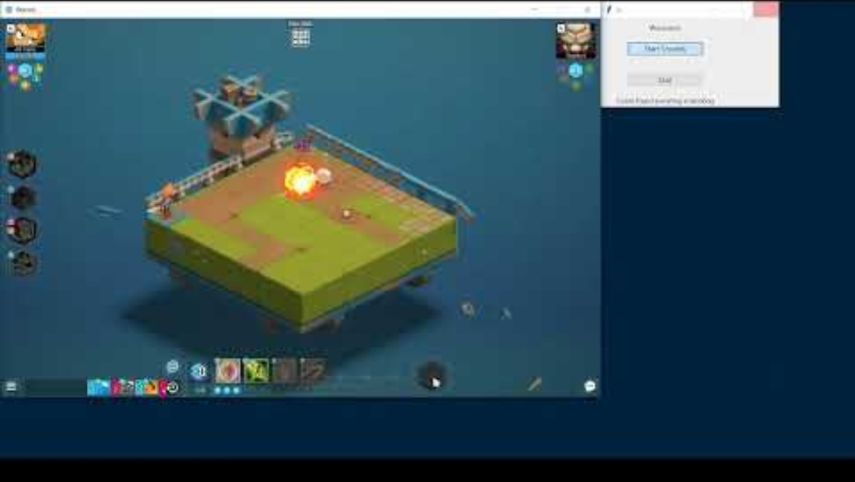
Presentation Video

Slide 6
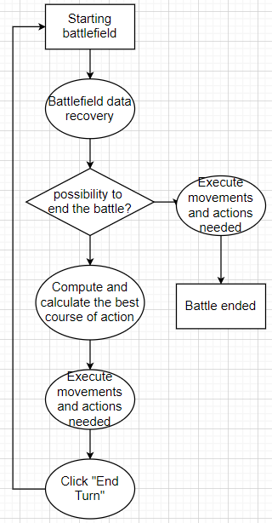
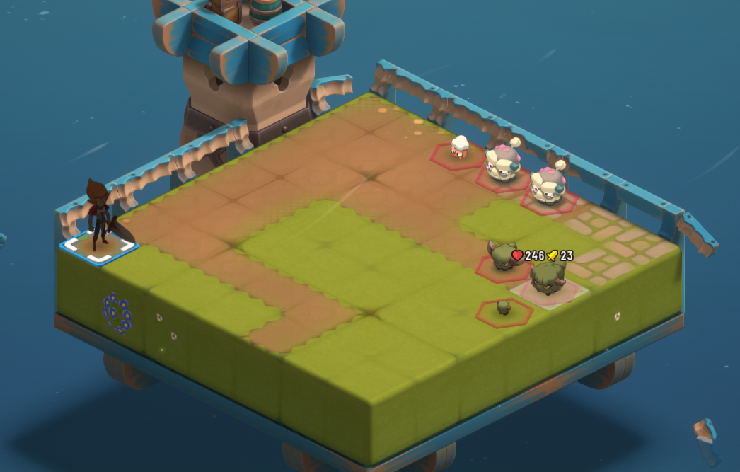
How it works

Slide 7
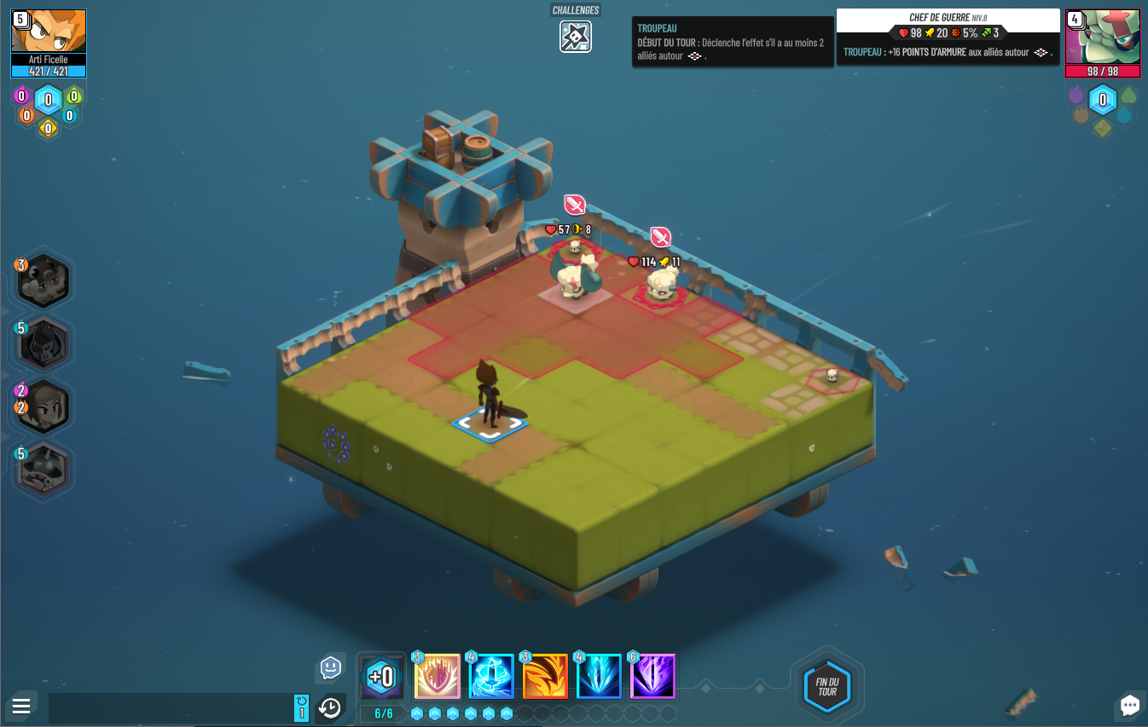
Data Recognition
Stats screen
Available spells

Slide 8

Using Tesseract
Best Case Scenario : 142 . |0 b4
Worst Case Scenario : Pre :
o0

Slide 9
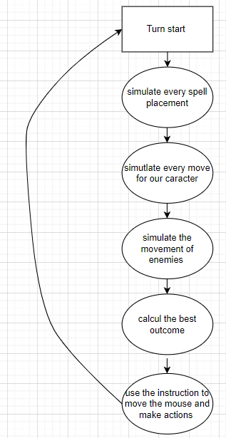
Understand our AI

Slide 10
Thanks for listening
By
LEFEBVRE Romain
HIRTH Quentin
LEDRU Solal
CARRE Arthur

